Slide 1
Software Requirements Specification for Online Election Voting App Management System

Slide 2
Table of Contents
Table of Contents iii
Revision History iii
1. Introduction 1
1.1 Purpose Error! Bookmark not defined.
1.2 Document Conventions Error! Bookmark not defined.
1.3 Intended Audience and Reading Suggestions Error! Bookmark not defined.
1.4 Product Scope 1
1.5 References Error! Bookmark not defined.
2. Overall Description 2
2.1 Product Perspective 2
2.2 Product Functions 2
2.3 User Classes and Characteristics 2
2.4 Operating Environment 3
2.5 Design and Implementation Constraints 3
2.6 User Documentation 3
2.7 Assumptions and Dependencies 3
3. External Interface Requirements 4
3.1 User Interfaces 4
3.2 Hardware Interfaces 4
3.3 Software Interfaces 6
3.4 Communications Interfaces 6
4. System Features 6
4.1 System Feature 1 Error! Bookmark not defined.
4.2 System Feature 2 (and so on) Error! Bookmark not defined.
5. Other Nonfunctional Requirements 12
5.1 Performance Requirements 13
5.2 Safety Requirements Error! Bookmark not defined.
5.3 Security Requirements Error! Bookmark not defined.
5.4 Software Quality Attributes Error! Bookmark not defined.
5.5 Business Rules Error! Bookmark not defined.
6. Other Requirements 13
Appendix A: Glossary 14
Appendix B: Analysis Models 14
Appendix C: To Be Determined List 14

Slide 3
Introduction:
1.1 Purpose
A software platform called an online voting system enables organizations to safely conduct elections and votes. The foundation of a democracy in which the people choose the ruler of their state is a system of open elections. The election uses a manual election mechanism, as we are all aware, and this leads to several issues. Because of this paper’s ballot-based election system, some issues arise for voters before or during elections, while others affect the administration before and during the voting. For voters as well as election administrators, many electronic voting options lack transparency. The implementation of e-voting can erode faith in the entire election process if it is not carefully planned and structured. Consequently, we are planning to open up to avoid this situation. Apps in an online system, which include mechanisms for voter registration, and voting, A excellent replacement arrangement would involve counting votes, declaring outcomes, etc. current system. Consequently, computerized voting technology aims to accelerate vote counting, minimize the expense of paying people to physically count ballots, and can deliver improved accessibility for voters with disabilities. Additionally, results can be delivered more quickly and in detail.
1.2 Document Conventions
Language: English
Font: Times New Roman
Headings: Bold, font size 14
Content: Times New Roman, font size 12
Product Scope
This system applies to the online voting app. This app facilitates users to a user-friendly app. They can create an account for themselves and log in.
When the voter votes for any candidate, they should give the fingerprint or take photos himself/herself to confirm the vote. The voter can vote one time and get the confirmation message to their account and phone number

Slide 4
The candidate users can Register for their Nomination Login profile with username and password and View updates of voting results.
And the Election Authority user can verify single-vote verification, which ensures members don’t inadvertently vote more than once Verify/edit results, Generate Reports of elections and Generate result transcripts finally Authorize the result of elections
Maintaining the database of users.
users can reach out to the admin for help/ file a complaint or give feedback to the app through email.
1.4 Reference:
¬ Inside ASP.NET Web Matrix by Alex Homer and Dave Sussman
¬ Building Secure ASP.NET Applications: Authentication, Authorization, and Secure Communication
¬ ASP.NET 4.0 Unleashed - Sams
¬ Pro .NET Best Practices – Alsher
¬ Professional ASP.NET MVC 3 - Publisher: Wrox; 1st edition
¬ http://www.w3schools.com/aspnet/default.asp
¬ http://asp.net-tutorials.com/
¬ http://weblogs.asp.net/
¬ http://www.mono-project.com/ASP.NET
¬ http://wiki.asp.net/
¬ http://en.wikipedia.org/wiki/ASP.NET

Slide 5
2. Overall Description
2.1 Product Perspective
Voters may effortlessly cast their ballots using our web-based online voting application, and administrators can quickly handle everything from voter management to voter authentication to manager and staff additions to election-related tasks. The administrator will prevent any link between the voter's identity and the vote cast in this app to protect the vote's confidentiality. and Users to use our software without any assistance from humans. The software enables us to carry out several tasks, such as casting a vote for the candidate of our choice. This online voting program can improve accessibility, for instance by allowing internet voting as well as voting from overseas and for voters who are housebound. Voters may simply cast their ballots using this web-based online voting application, and administrators can control all of those things, including managing voters and voters.
2.2 Product Functions
The main objective of our project is to have an impartial election system and everyone can easily vote for the candidate of their choice
The software allows users to create their accounts by signing up using their name (as the same NID), NID, and the same login credentials. Once the user(voter) creates a verified account, he/she can vote for their chosen candidate, Voter Can Register and log in with his voter’s ID card. Voters can view candidates. Voters can cast a vote and get the confirmation message and voters can provide and scan their fingerprints for casting votes in this app.
The candidate users can Register for their Nomination Login profile with username and password and View an update of the voting result.

Slide 6
And the Election Authority user can verify single-vote verification, which ensures members don’t inadvertently vote more than once Verify/edit results, Generate Reports of elections Generate result transcripts finally Authorize the result of elections
2.3 User Classes and Characteristics
The user should be familiar with this app like any basic app and be easy to use.
Voter and candidate users don't have to be very experienced to use the app, they can easily use the app if they have normal basic knowledge, and social media will also give them ideas.
The election authority should be trained to use and access this app
2.4 Operating Environment
The app will operate any kind of Android, iPhone, or website (Desktop and Mobile)
2.5 Design and Implementation Constraints
The Design and Implementation major constraints that the project are as follows:
The user must have an active verified phone number and enter a valid NID card/number which should be verified by Election Commission Bangladesh-NID to sign up first and he has to fill in his/her details to enter the main page.
When the voter votes for any candidate, they should give the fingerprint or take photos himself/herself to confirm the vote. The voter can vote one time and get the confirmation message to their account and phone number
The security level is very high which can maintain privacy and policy
User can select their preferred language
The app is virtual and the user must have active internet access.
The app requires a minimum memory of 2GB for better performance of the App

Slide 7
2.6 User Documentation
YouTube
Facebook
Tv channel
Social media
App has an interface for tutorials
The app stores the play store, App Store, and the also website link
2.7 Assumptions and Dependencies
The assumptions are:
the coding ought to be flawless.
The system ought to be more capable and offer quick database access.
The system offers a search feature that shows all of the user's search results.
The app should be simple to use so that consumers can easily use it.
Access to the website is possible from any device with an active internet connection.
To access their online accounts and utilize the app, users must have their correct usernames and passwords.
The dependencies are:
The specific hardware and software due to which the user gets the confirmation message.
The information of all users must be stored in a database that is accessible by Admin and the election authority

Slide 8
3. External Interface Requirements
3.1 User Interfaces
In this Online Voting App, four types of users will use this system:
1. Voter:
Voter Can Register and log in with his voter ID card.
Voters can view candidates.
Voters can cast a vote
Voters can provide and scan their fingerprints for casting a vote in this app.
2. Admin: Admin can alter each thing. Additionally, can maintain the entire system and delete something in case he finds anything offensive.
Admin can maintain the entire system.
Modify the candidate’s Information.
Modify Election Authority Information.
Modify Electoral Information.
Add voting time duration.
3. Election Authority: They can verify single-vote verification, which ensures members don’t inadvertently vote more than once
Verify/edit results
Generate Reports of election
Generate result transcript
Authorize the result of elections.
4. Candidate:
Register for his Nomination
Login profile with username/ Nomination Id and password.
View update of voting results.

Slide 9
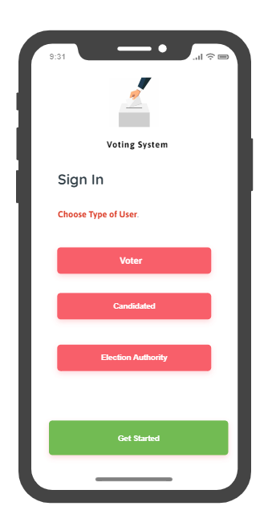
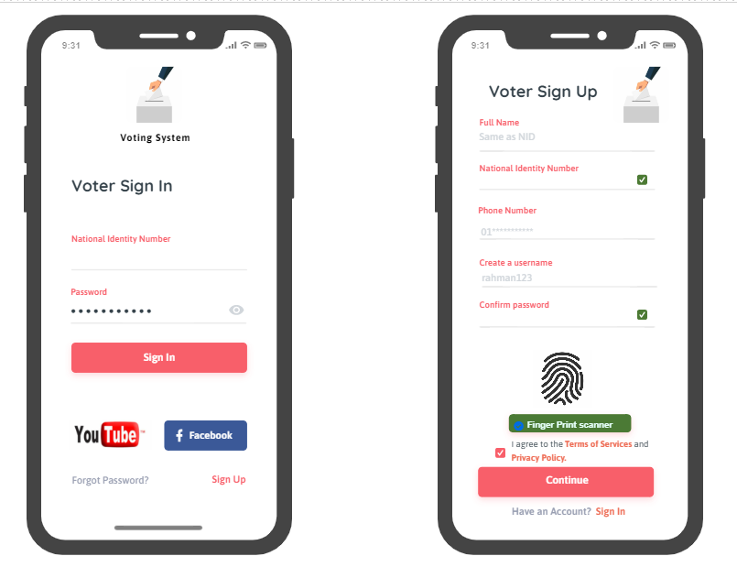
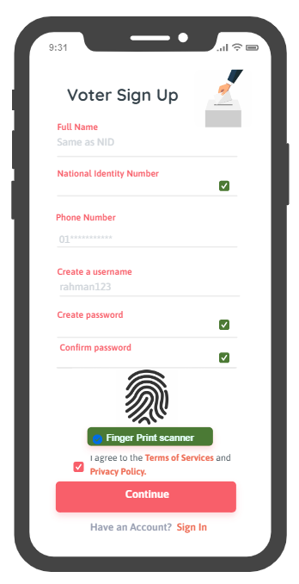
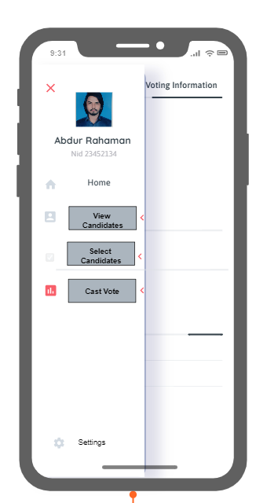
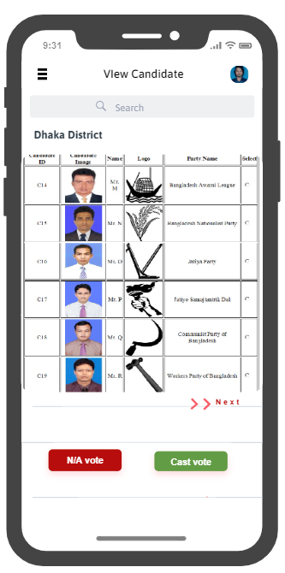
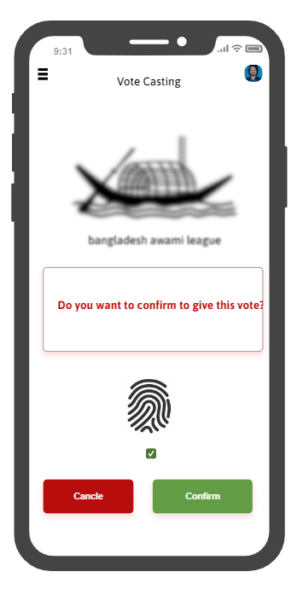
Voter Interface:

Slide 10
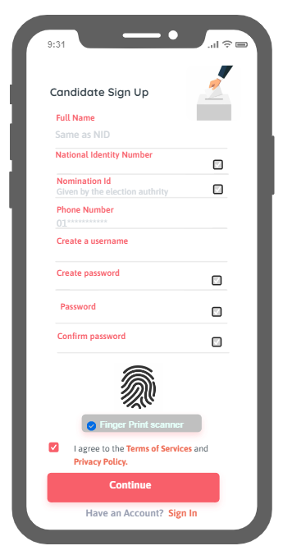
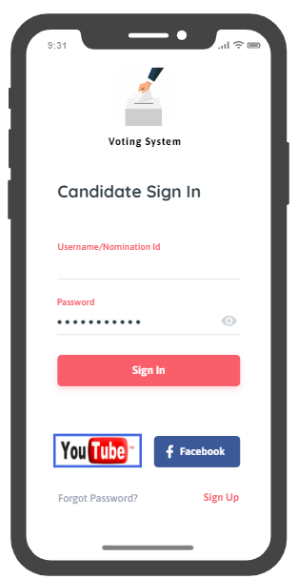
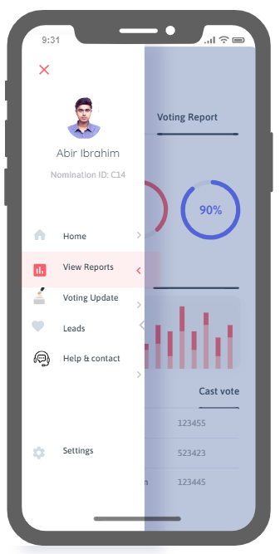
Candidate Interface:
Hardware Interfaces
Reference: https://app.moqups.com/

Slide 11
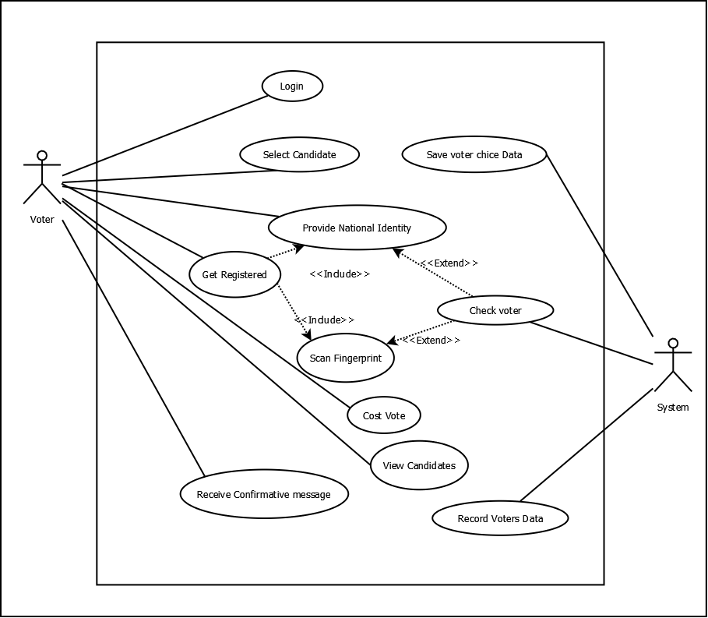
System Features
UML Diagrams:
Use Case Diagram:
Voter Panel:

Slide 12
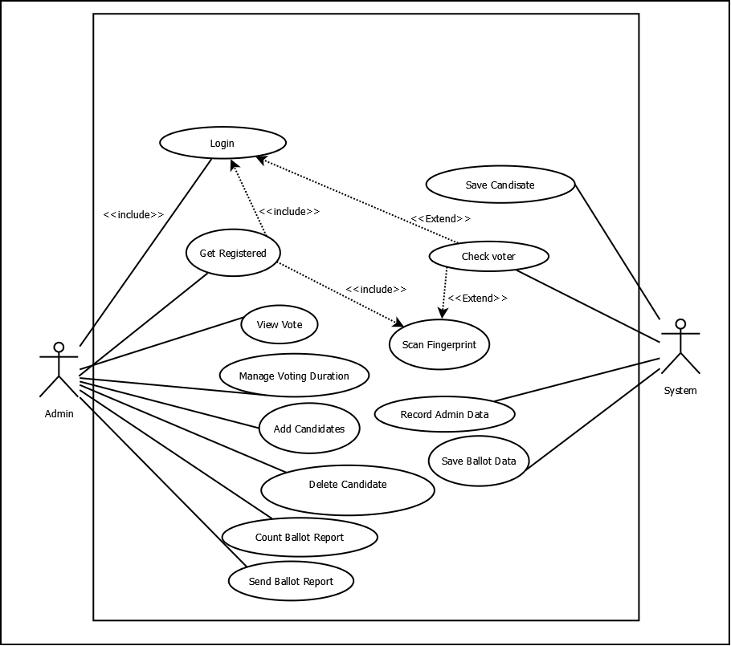
Admin Panel:

Slide 13
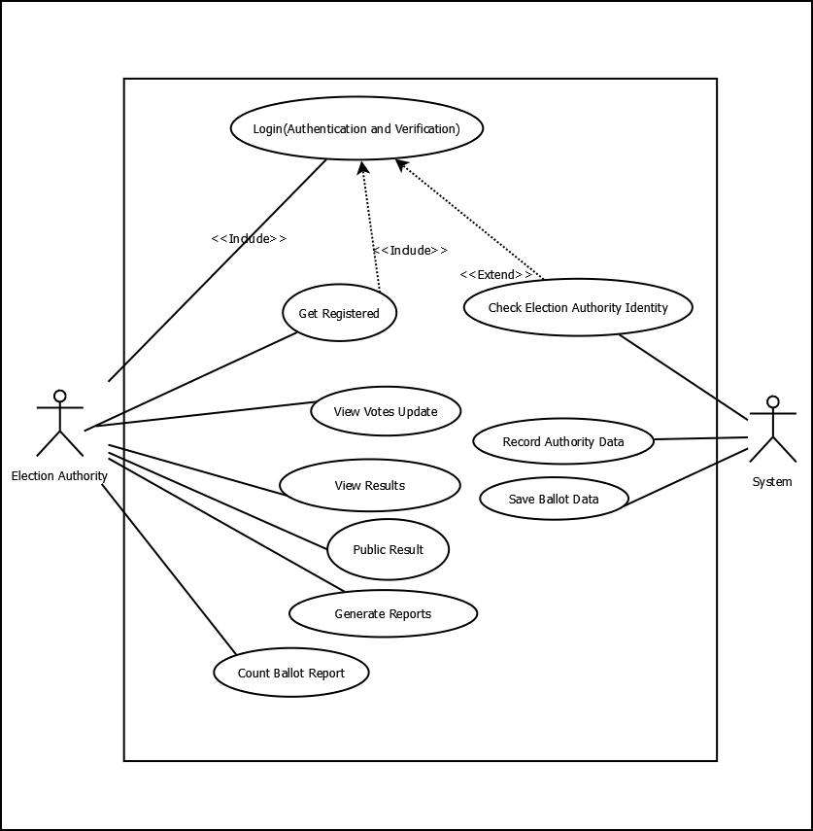
Election Authority Panel:

Slide 14
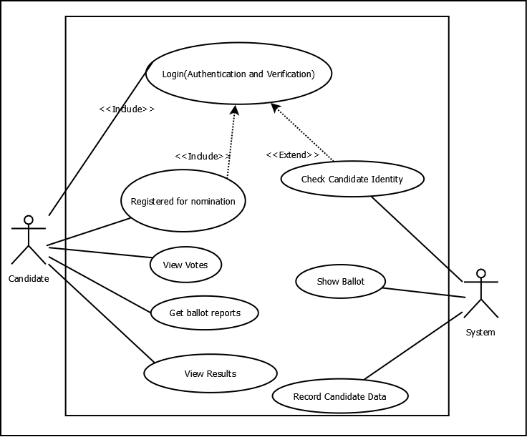
Candidate Panel:

Slide 15
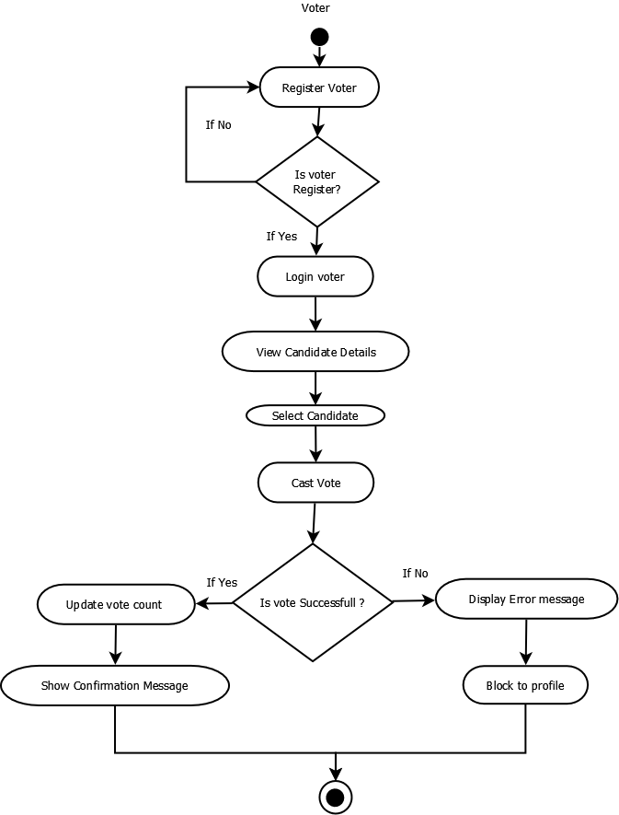
UML Activity Diagram:

Slide 16
4.1 Components of the System:
4.1.1 Description and Priority
In this Online Voting App, four types of users will use this system:
Voter:
Benefit: Hight 9
Penalty: Low 1
Cost: High 8
Risk: Low 1
Election Authority:
Benefit: Hight 8
Penalty: Low 1
Cost: High 9
Risk: Low 1
Candidate
Benefit: Hight 9
Penalty: Low 2
Cost: High 7
Risk: Low 1
4.1.2 Functional Requirements
An explanation of the service that the software must provide is contained in a functional requirement (FR). Our program:
The electronic voting machine, or EVM:
Capable of storing voter data
Can monitor voter status
Can check whether a waiting room is available
The system can produce a voter list.
Can calculate votes and voters.
Users' requests for appointments may be canceled.
The ability to change any appointment.
Can take particular needs into account.
Can verify voter identity.
Has a number checker for voter ID cards

Slide 17
Other Nonfunctional Requirements
5.1 Performance Requirements
Nonfunctional Requirements: Non-functional requirements emphasize how the system functions rather than how it behaves.
Compliance: Because our application complies with software standards, bugs, security problems, and design flaws are less likely to be present.
Privacy: To secure its users' privacy, privacy software can be created. To regulate or cap the quantity of information made accessible to third parties, the program often works in tandem with Internet usage. A variety of encryption and filtering techniques can be used by the software.
Quality: It's an essential element of software. To avoid wasting time and money, it aids in the identification of mistakes and weaknesses in the software design and code throughout the development process.
Reliability: For the majority of software, it is a significant non-functional need. It is typically described as the likelihood that our product will work flawlessly for a predetermined number of transactions or for a predetermined amount of time.
Response time: It is the time it takes for the Application Server to give the user the results of a request. For software, a stable and quick system is crucial. The response time shall be kept as quick as possible.
Scalability: The capacity of a system to adapt its performance and cost in response to changes in application and system processing demands is known as scalability. Software systems, it is a crucial necessity.

Slide 18
6. Other Requirements
Client: A client is an individual who utilizes services.
Interface: A computer system's interface is a shared border where two or more independent components can communicate data, such as (Election Commission Bangladesh-NID Server)
User Interface: This section refers to the elements that the user directly interacts with.
Test Case: The series of procedures needed to validate a particular feature or functionality is referred to as a test case.
Data: Data is the private information that the user has submitted.
User Case: A high-level project diagram that provides a fundamental overview.
Unique Key: used to distinguish database entries.
Backend: The area of a computer system or program that a user cannot access directly and is usually used for data storage and manipulation.

Slide 19
Internet: A huge network that users must have access to interact with many computers and use the program.
Frontend: Refers to the area of an application with which the user directly interacts; primarily used in online and mobile app development.
Class Diagram: This kind of static structure diagram illustrates a system's cases, their attributes, and the relationships between the classes to describe the system's structure.
Database: A database is a type of data structure used to hold structured data about a user and the products in his cart.
Appendix A: Glossary
Appendix B: Analysis Models
Appendix C: To Be Determined List

